Slide 1

High Assurance Cloud Compute and Storage
S21 Team Ironware Midterm Presentation
Sponsors:
National Security Agency
Joshua Cline
Eric Darko
Jason Smith
Team Members:
Khalid Abusultan
Chetan Garikapati
Monish Alur Gowdru
Giakhanh Hoang
Travious Lewis

Slide 2
Overview
With an increasing adaptation of containers, there is a growing need for solutions to securing containers and their data
Our goal:
Research container exploits
Review existing container hardening solutions/techniques
Develop a comprehensive approach to securing containers and their data
Notes:
Securing data also includes data sanitization

Slide 3
What is a container
A lightweight solution to packaging an application's environment altogether for easy testing and development
  Examples: Docker, Kubernetes
Hosted on servers within operating systems
  May be configured to access the host's resources
Can communicate with other containers
Notes:
An application's environment includes a guest OS and any other environmental variables.
A host's resources include hardware resources like the CPU/GPU, or even the host file system if configured to do so.
It pretty much is a abstract, condensed package to serve as a component for a larger system/as part of a scalable system.

Slide 4

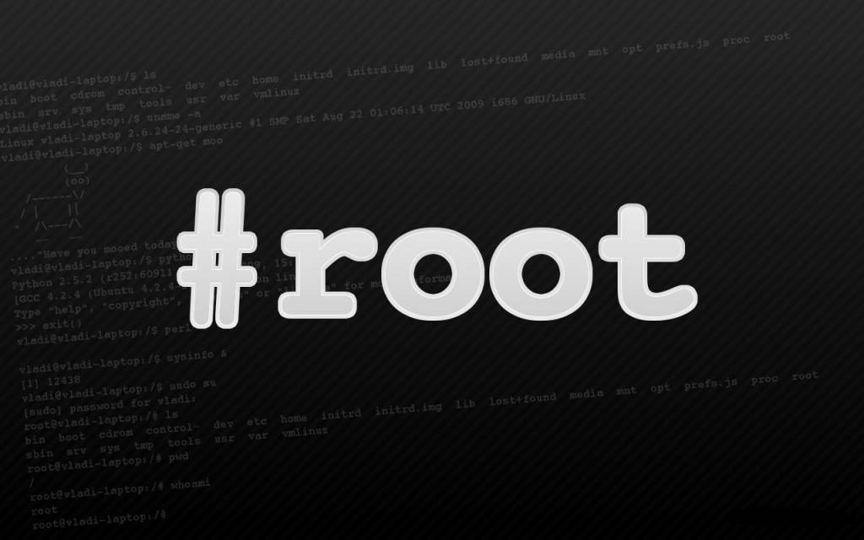
Docker Security Concerns
Root privileges are needed on the Linux host or kernel installation
  Pose security threat if poorly managed
  A malicious user could leverage APIs to cause Docker to create new unauthorized containers
Lib containers
  These containers can be compromised by a root since they are all under '/sys' directory
Daemon approach
  Everything is running as root which causes vulnerabilities
More feature addition
  Docker becomes more vulnerable every time a new feature is added

Slide 5
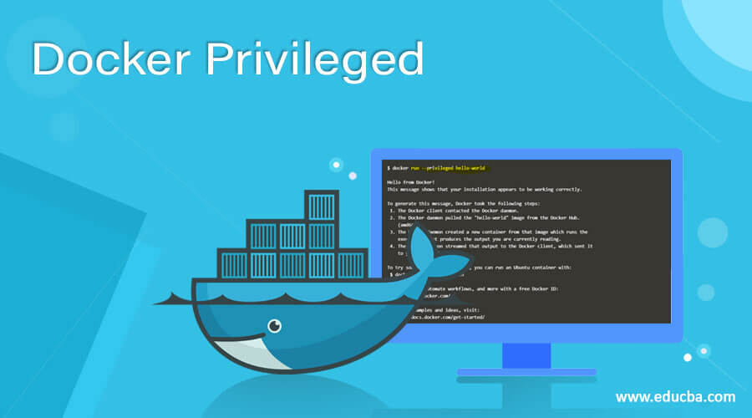
Docker Hardening Techniques
Linux hardening techniques can be used on docker (Docker is based on Linux container)
Below are some of the techniques that can be used
  Do not run privileged on containers
    It is not necessary to have every user by default to run on priviliged
    Use "--security-opt" for containers instead which is compatible with SELinux/AppArmor
  Drop and observe dropped capabilities
    Control different capablilites of processes
    Distinguishing between privileged and unprivileged processes

Slide 6

Privilege Escalation
Obtaining access to restricted resources from unprivileged account by exploiting weakness
Vertical escalation from normal user to super user and Horizontal escalation from user to user at same level
Vertical escalation is obvious but horizontal can also be very detrimental to the system security especially in cloud environments
Some of the known exploits

Slide 7
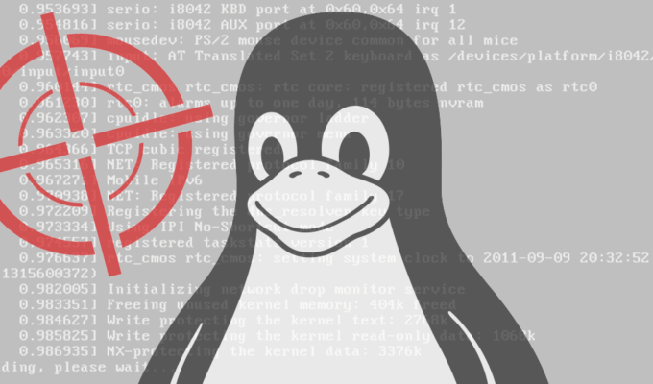
Escalation By namespace remapping
In docker we use “userns-remap” option to provide non-privileged user access to a docker image as root.
This option can is enabled by changing the “daemon.json” file or as argument at startup.
The docker daemon runs in privileged mode as it requires complete access on host resources.
The root user in the docker instance can modify files in “/var/lib/docker/<remapping>” path, which causes files to be written with extended privileges in host system.
Using this we can write a script file which gives root privileges to normal user in the host system causing a vertical privilege escalation.

Slide 8

Escalation from trusted binaries
This exploit is specifically targeted for windows systems.
Docker by default tries to load files with predefined names from the libraries path.
For login prompt, the docker uses “docker-credential-wincred.exe” file.
This executable will be invoked with admin privileges by docker daemon.
If this file is modified then any user can obtain root privileges and can also create user account on host system.
This Photo by Unknown Author is licensed under CC BY-SA-NC

Slide 9
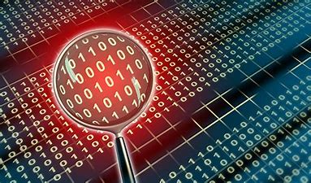

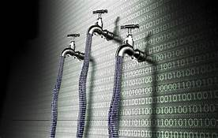

Data Storage Risks at Cloud
Usually, data is not sanitized the consequences is that data is at risk of being exposed.
Data deletion is incomplete.
Data spillage.
Data breach leaked information of 3,000 patients due to improper data management.

Slide 10

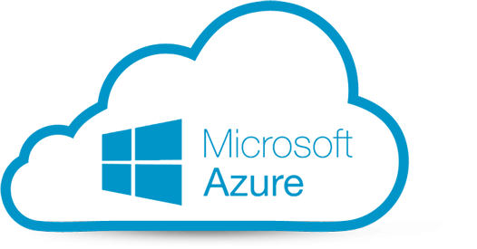
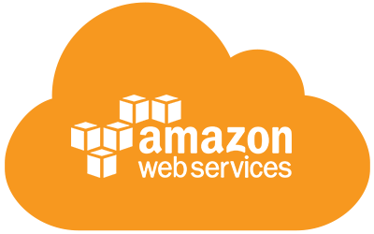
Cloud Based Data Storage Sanitization Standards
DoD standards
Google Cloud Standards
Microsoft Standards
Azure Standards
Techniques that can be used to protect data.

Slide 11
Future Plans
Experiment implementing Linux hardening techniques using Docker and RedHat OpenShift
Develop and implement a solution for Privilege Escalation exploits
More research into cloud data storage sanitization techniques
Data Storage Sanitization
  Speak with security experts from various organizations to check with any alternative solutions.
  Try to build a technology to solve the problem to improve efficiency of data sanitization.

Slide 12
REFERENCES
("CVE-2019-15752 : Docker Desktop Community Edition before 2.1.0.1 allows local users to gain privileges by placing a Trojan horse docker-c", 2021)
("CVE -CVE-2021-21284", 2021)
("Docker userns-remap and system users on Linux", 2021)

Slide 13

Thank you!
Any Questions ?

